Slide 1

Travelogue Divination

Slide 2
Problem Statement
Most of the ticket booking applications doesn’t include live tracking, time prediction and other facilities. Hence, there are hardships to locate the live status of a booked entity (Bus, Train, Flight).
Time plays a significant role in our life. All are time-bounded in their daily activities. So, planning a journey without knowing the details of the routes one have to travel may become time consuming and a hectic task.

Slide 3
Solution
An all-in-one web application integrated with many services that a passenger needs.
Ticket booking facility for bus, train and flight.
Passenger can track the live location status of the booked entity.
A time prediction mechanism based on historical data and current location which is a highlight of the application can provide a hassle-free journey.
Tourism facility is also included as an add-on where the passenger can analyze major spots in the destination.

Slide 4
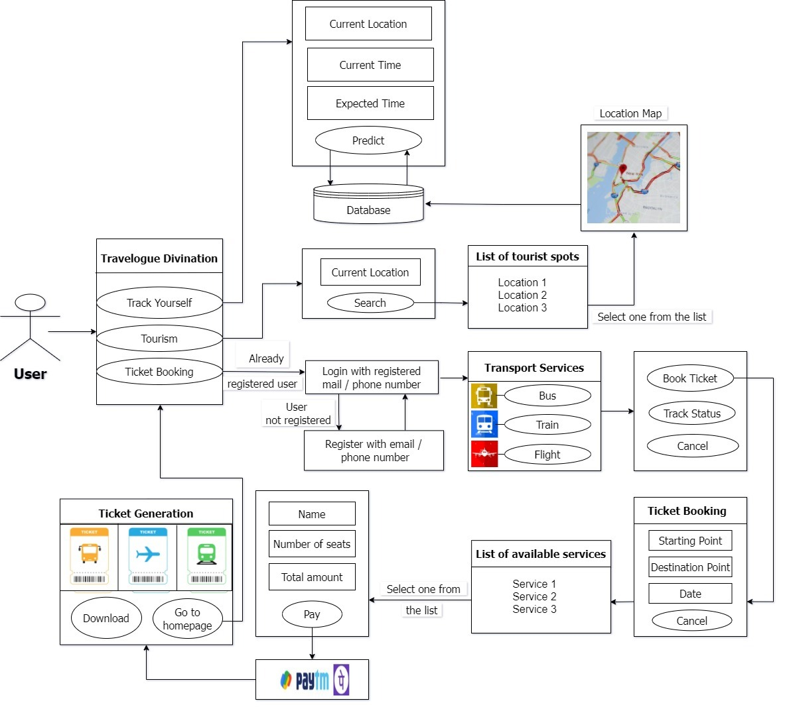
Architecture

Slide 5
Implementation
Inputs: current time, current location and expected time/location
User
Web application
Output: Predicted time/location

Slide 6
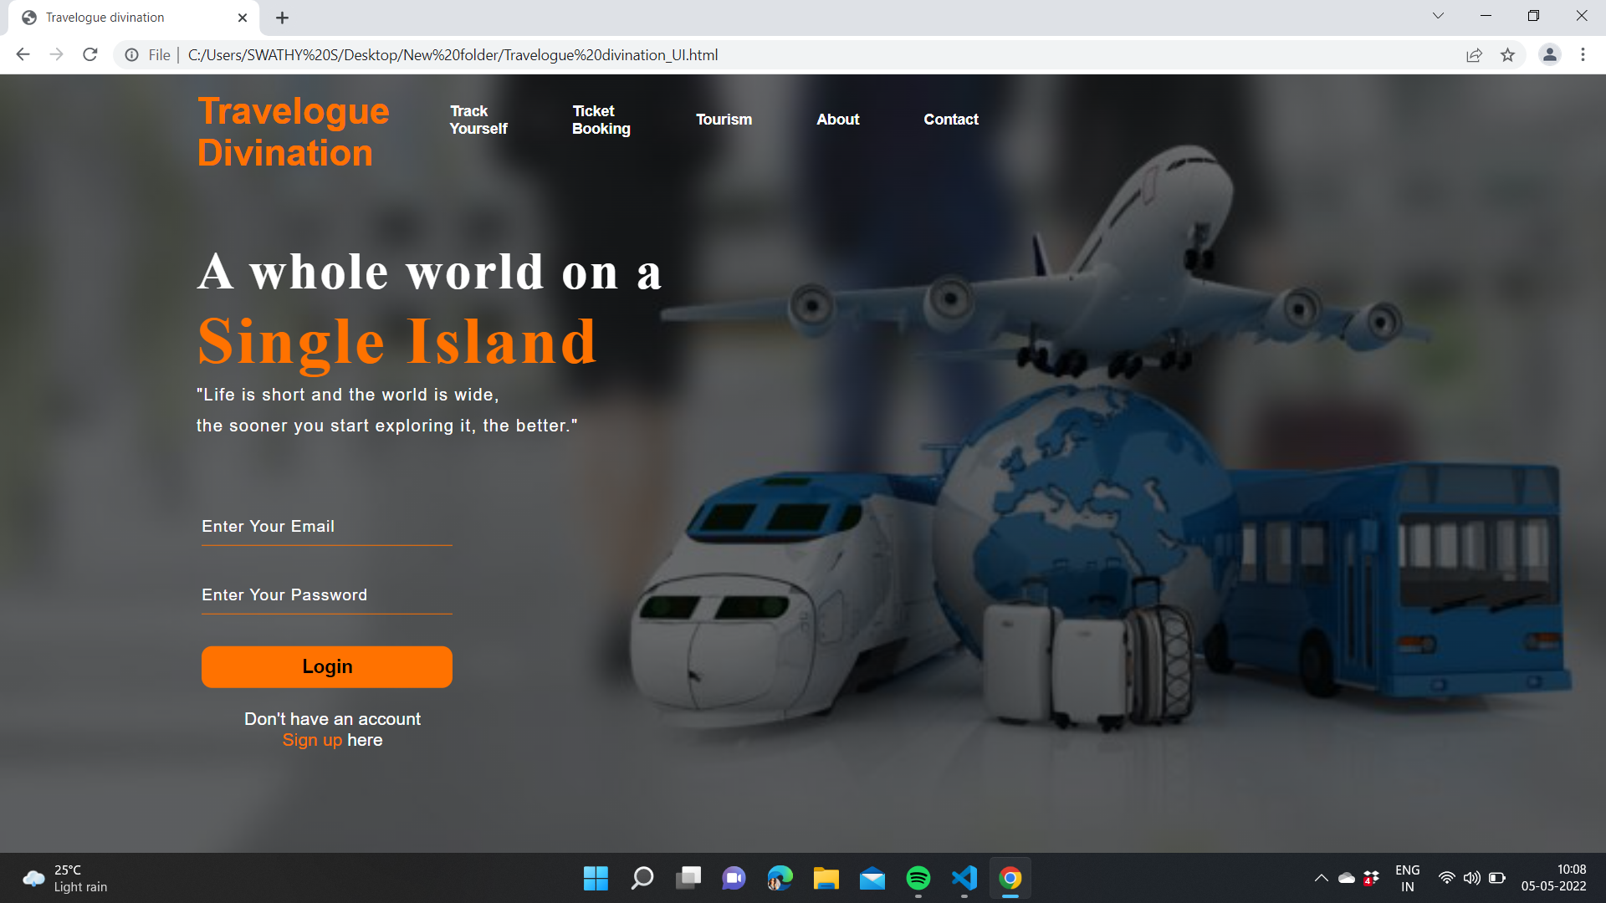

Slide 7
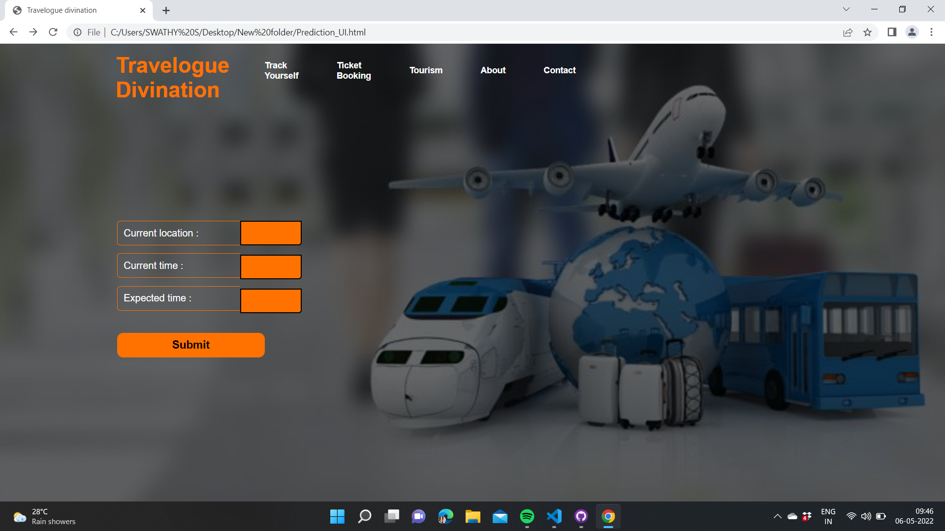

Slide 8



Technical Side
It is used to develop computer programs, as well as websites, web apps, web services and mobile apps.
SQLite is the most widely deployed database engine
It has bindings to many programming languages.
It is an micro-framework that allows us to build up web applications.
It is uses Python for the backend.

Slide 9
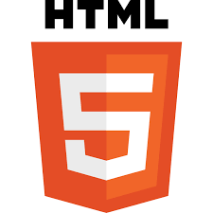


Technical Side(Contd…)
It is an interpreted high-level general-purpose programming language.
HTML is the standard markup language for documents designed to be displayed in a web browser.
Cascading Style Sheets is a style sheet language used for describing the presentation of a document written in a markup language such as HTML.

Slide 10
Advantages
A travel-time management app
Easy to use
Simple design
Live tracking facility
Can be used as a tourism guide
Reduces the hardships a passenger faces

Slide 11
Future Works
Inclusion of optimisation to already made travel plans.
Time prediction based on traffic blocks in the passenger routes.
A facility for the passengers to add the experience so that others get an idea about the route.
An online chat support to the passengers

Slide 12
Thank you

